Slide 1
SoCV Final Project
2017/06/02
music960633

Slide 2
Property Directed Reachability
I believe everyone has read the PDR paper
If you still don’t understand PDR…
That is absolutely normal XD

Slide 3
PDR overview
in 5 slides

Slide 4
PDR frames
PDR maintains over-approximations of reachable states from previous timeframe
Every frame except the last frame do not intersect with bad states
bad
bad
F₂
bad
F₁
F₁
F₀ = I
F₀
F₀

Slide 5
PDR frames
PDR use CNF to represent frames, a clause in F_{k} must exist in F_{k-1}
F₂
F₁
F₀ = I
N/A
(a+b+c)(!a+!c)(a+d)
(a+b+c)(!a+!c)

Slide 6
Recursively block cubes
If F_{n} intersects with bad states, we should block those states in F_{n} and recursively block cubes in previous frames
Block cube (abc) at frame k -> add clause (!a+!b+!c) to F_{k} and all previous frames
bad
bad
F₂
UNSAT
bad
UNSAT
F₁
SAT
F₀ = I

Slide 7
Propagate blocked cubes
After inserting a new frame, check all the cubes if they can be blocked in later frame
If F_{k} = F_{k+1} for some k, F_{k} is an inductive invariant
bad
bad
bad
SAT?
F₂
F₁
F₀ = I

Slide 8
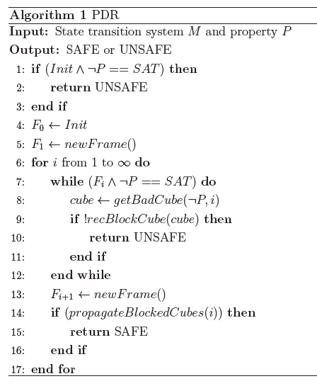

Slide 9
Any questions so far?

Slide 10
Recursive block cubes
SAT? [F₁ & Tr & s’]
How to query this using SAT solver?
bad
F₂
bad
s
SAT?
F₁

Slide 11
Recursive block cubes
SAT? [F₁ & Tr & s’]
Tr: Tseitin transform (addBoundedVerifyData)
s’: use assumption
assume (ab!c) -> assume a’ = 1, assume b’ = 1, assume c’ = 0
F₁ : ???
How to constraint the states in different frames?

Slide 12
Solving SAT in different frames
Solution 1: every frame has one SAT solver, do not need to assume
(not used in final project)
Frame 0 No solver | Frame 1 solver 1 | Frame 2 solver 2
N/A | add clause (a+b+c) add clause (!a+!c) add clause (a+d) | add clause (a+b+c) add clause (!a+!c)

Slide 13
Solving SAT in different frames
Solution 2: use only one SAT solver (used in final project)
A clause is only stored in the highest frame that has this clause
assume F_{k}: assume all clauses in frame k ~ frame INF
How to assume a clause?
Frame 0 | Frame 1 | Frame 2 | Frame INF
N/A | (a+d) | (a+b+c) (!a+!c)

Slide 14
Solving SAT in different frames
Assume a clause: add an activation variable v
activate the clause when v = 1
Ex: assume (a+b+c)
add clause (!v+a+b+c)
see blockCubeInSolver()
Every frame has its own activation variable v₁…v_{n}
assume F_{k}: assume v_{k}=v_{k+1}=…=v_{n}=1
see solveRelative()

Slide 15
What you need to implement

Slide 16
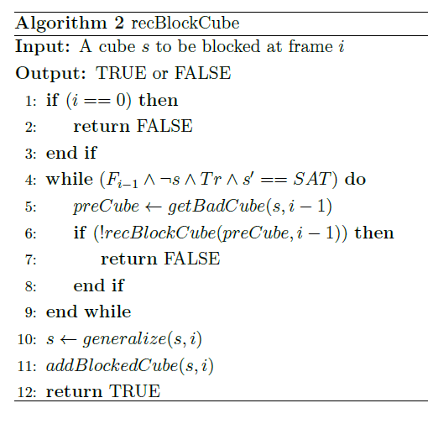
SAT generalization
UNSAT generalization

Slide 17
SAT generalization
Solver will assign each variable a value if SAT
Try to make some latch to don’t care to expand the cube
see ternarySimulation()
1
circuit
1
x
circuit
1
1
0
x
0
1
1
0
0
0
1
x
1

Slide 18
UNSAT generalization
Not all variables in a cube is necessary for UNSAT
We can use UNSAT core to do UNSAT generalization
see UNSATgeneralizationWithUNSATCore()
The generalized cube cannot intersect with R₀
In the original implementation, if the generalized cube intersects with R₀, it will return the ungeneralized cube
You can do better

Slide 19
Data structures
class Value3
faster operation
class Cube
Always allocate an array of size (# of latches) to store a cube
A generalized cube may contain only a few latches
faster Cube::subsume() (ex: hash)
Serious memory leak

Slide 20
Other Heuristics
Order of latches in ternary simulation
Order of poped cubes in recursiveBlockCube()
currently only sort by timeframe
sort by something else when timeframes are the same?

Slide 21
Grading policy
Run score is evaluated similar to HW5
If you implement something else that is not effective, you can comment them in the code and mention it in the report and presentation
Don’t claim an idea you didn’t implement
Please don’t turn in default code
You will get very low score

Slide 22
Have fun!

